Slide 1
Cloud Architect Nanodegree Program
P2: Cost Optimization and Monitoring for Your Company
Dhruv Kinger
Udacity Mentor| SWE at ThrivePass

Slide 2
Today’s Agenda
Ice breaker activity
Project walkthrough
Project Tips & Tricks
QA

Slide 3
Ice Breaker : Let’s have fun 🤩😎 What crazy activities do you dream of trying someday?

Slide 4
Project Walkthrough

Slide 5
Project Summary
Company "X," which has offices in both the US East Coast and US West Coast. They currently host all their data and applications in a single East coast data center and are constantly worried about both cost and resiliency. In this project, you are given a series of steps to complete to compare on-prem costs to Azure-based costs and to configure resources within Azure.
You will submit screenshots and short explanations of the importance of the tools within Azure and how you can improvise their current architecture.

Slide 6
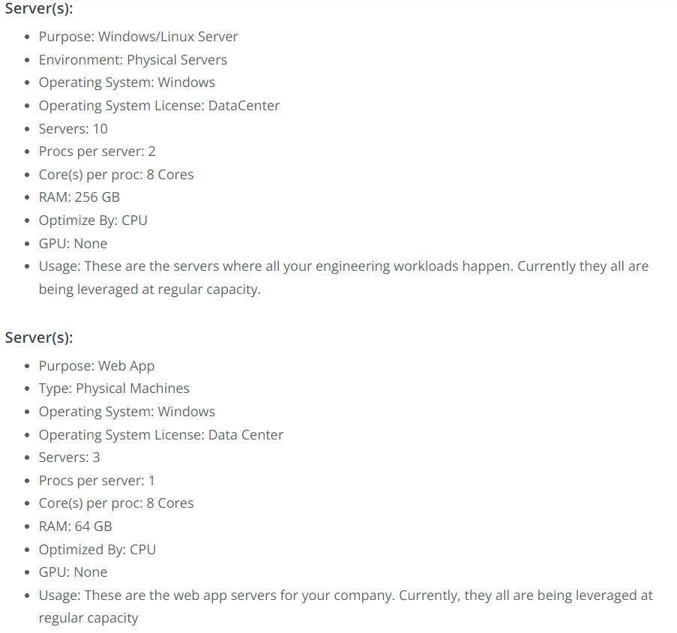
On Prem Servers

Slide 7
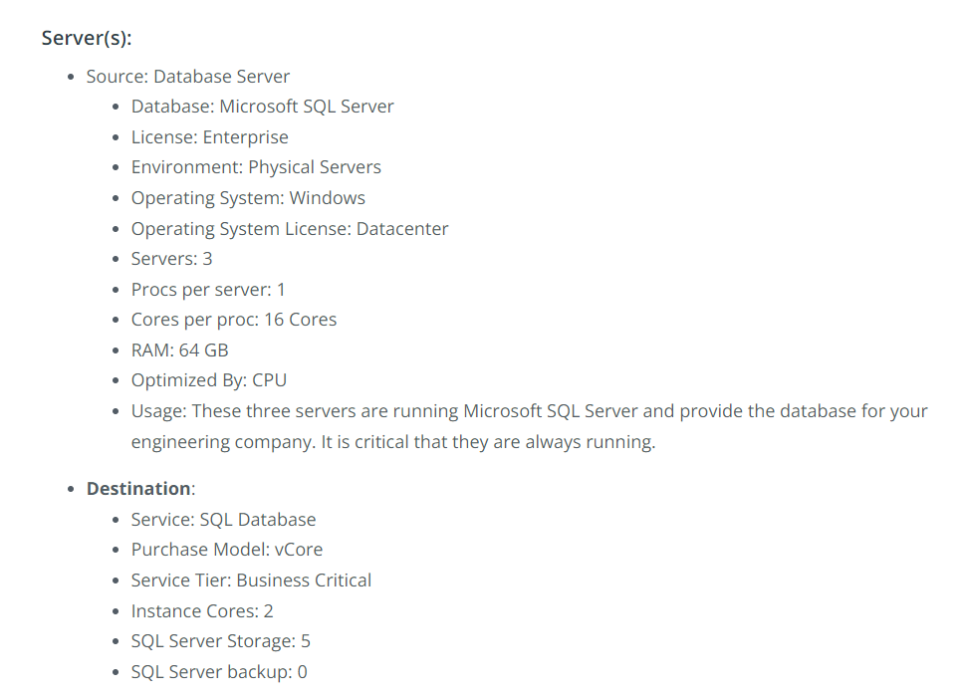
On Prem Servers

Slide 8
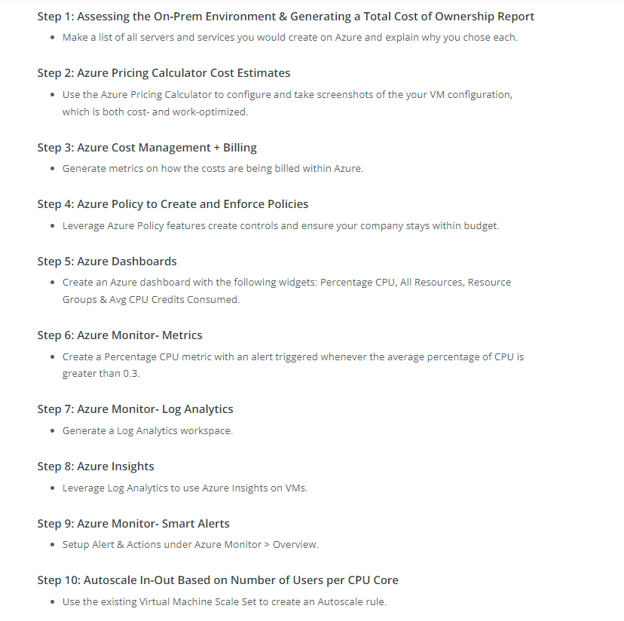
Expectations

Slide 9
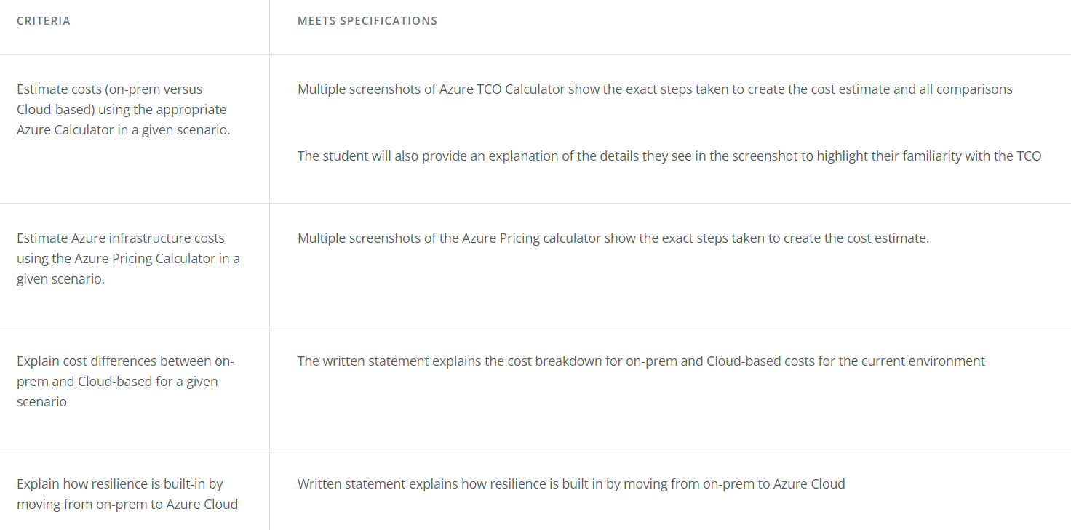
Rubric Points

Slide 10
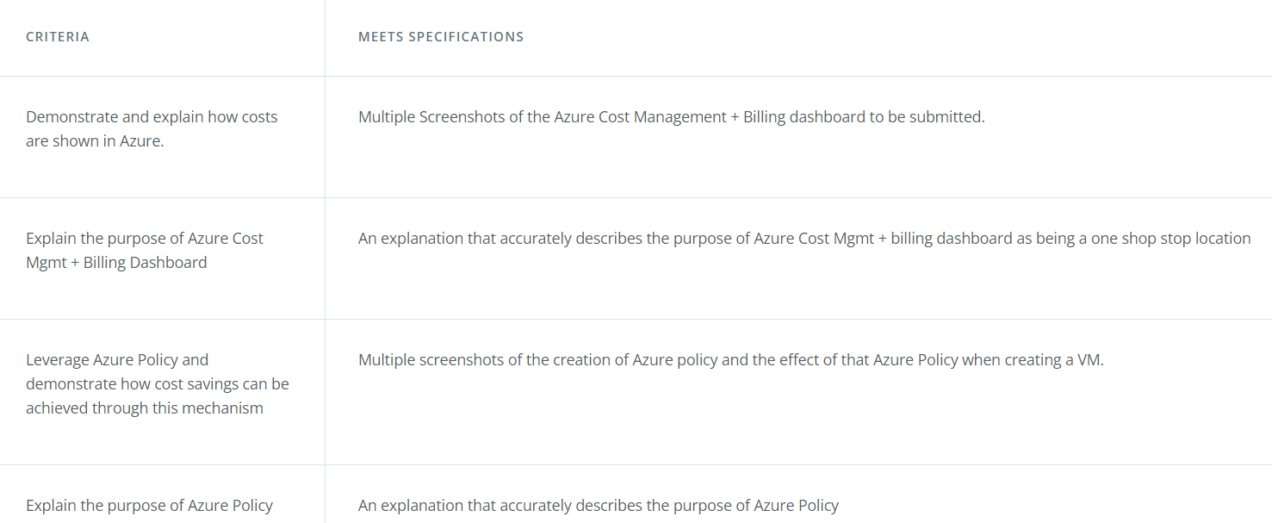
Rubric Points continued

Slide 11
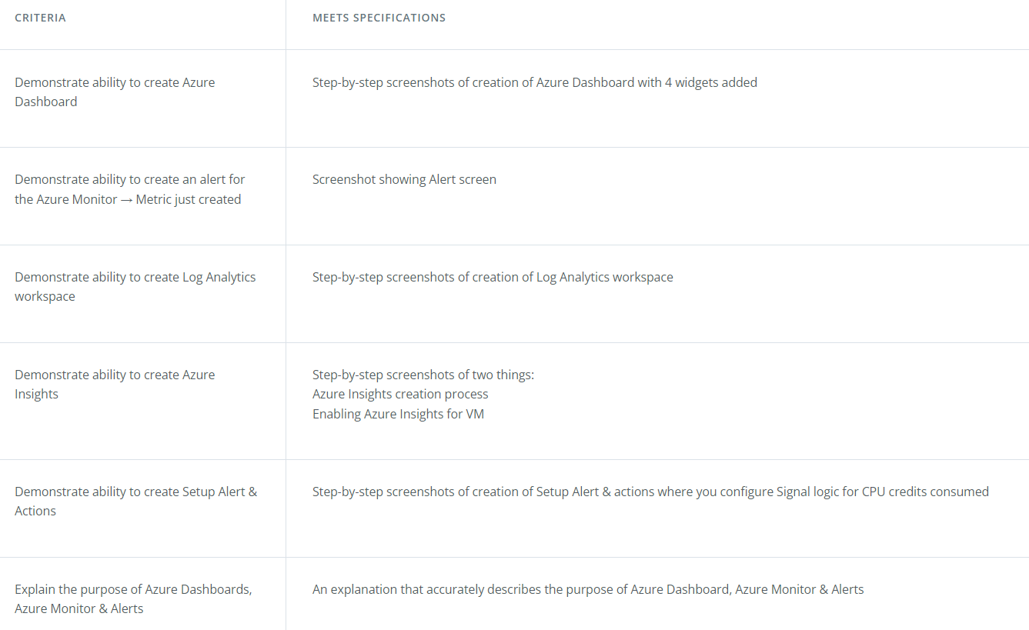
Rubric Points continued

Slide 12
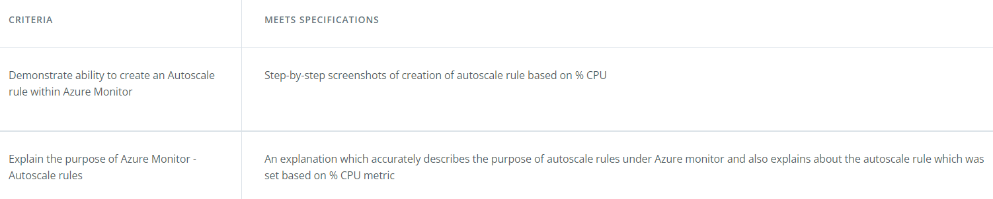
Rubric Points continued

Slide 13
Benefits of Moving to Azure
Data Security : Security in Microsoft Azure is built in at different levels and can be customized as per customer requirements. The security of data stored in Azure is managed by encrypting the data at rest through various mechanisms.
Data Resiliency (elasticity) : When you use Azure cloud storage, your data is physically stored in secure data centers operated by Microsoft. For example, the disks of the virtual machines that you use for your virtual machine are stored as page blobs in Azure storage.
Single-Pane Operations : Last but not the least, it is important to have a single pane of management to gain visibility and insights into what is happening with your infrastructure, & Azure completely fits into this.

Slide 14
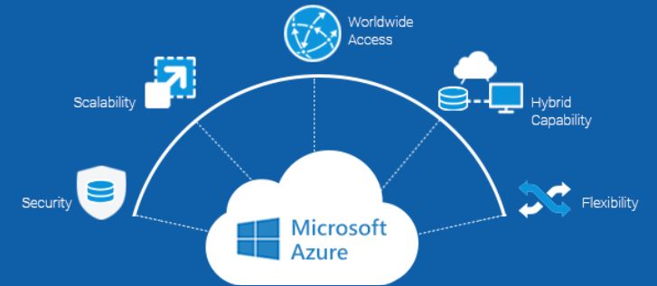
Let’s discuss

Slide 15
Governance in Microsoft Azure
Azure Policy allows you to create, assign, and manage policy definitions to enforce rules for your resources. Azure Policies keeps those resources in compliance with your corporate standards.
Role Based Access Control to manage who can access specific features, resources or implement new technologies.
Tenant and subscription management for deciding on the amount of tenants and subscriptions is something you want to get right from the start. Architecting the right structure for your tenants and subscriptions is a foundation of good governance.
Resource Tagging for organizing resources for cost management, technical management or just to create an overview. Without organising your resources things can become complicated.
Azure Cost Management to track cloud usage and expenditures for your Azure resources and other cloud providers.

Slide 16
Why to implement governance on Azure?
Security & compliance : Customers will demand some form of compliance, trust and security. And if you want to scale your business, you want that too. Through governance, resources can be configured consistently to manage security and compliance risks.
Consistency : In Azure you can choose to deploy a wide variety of technologies, scale your resources as big as you want and deploy them in whichever region you want. The fact that you have those capabilities does not mean you have to provide everyone with the ability to use all of them. In fact, you want to focus on specific technologies and make sure your team deploys them the way that you and your customers expect them to be deployed.
Controlling your costs : Implementing the correct guard rails will make your costs predictable.
Transparency : Controlling who has access to what, what’s running where and who is using it also gives you the possibility to be transparent to your customers.

Slide 17
Tips & Tricks
Use of Arm Template to deploy VM as you have done in Lab Exercise Deploy a Storage Account using an ARM Template.
Many Students keep on asking that whether they must deploy On Prem Servers ? Ask this Question from yourself.
Think of High Availability for the Designed Architecture in Azure ? Do you think is it well designed ? Even this is asked in Project Template.

Slide 18
Additional Resources
How to Setup a VPN ?
Want to read some of mine Azure Related Blogs ?
Thinking to get Microsoft Certified ? Here are some of the Paths.
Want to read Some More benefits of Arm Templates ? Do give a Read.
Want a Free Voucher for Microsoft Certification ? Do give a Read.

Slide 19
🤩 Yeah, it’s QA Time 🤩

Slide 20
🙏 Thanks 🙏
Want to Connect ?
Twitter Handle: @KingerDhruv
LinkedIn: https://linkedin.com/in/dhruv-kinger
GitHub: https://github.com/DhruvKinger

